Slide 1
How to work with GitHub
And get the best mark on this subject

Slide 2
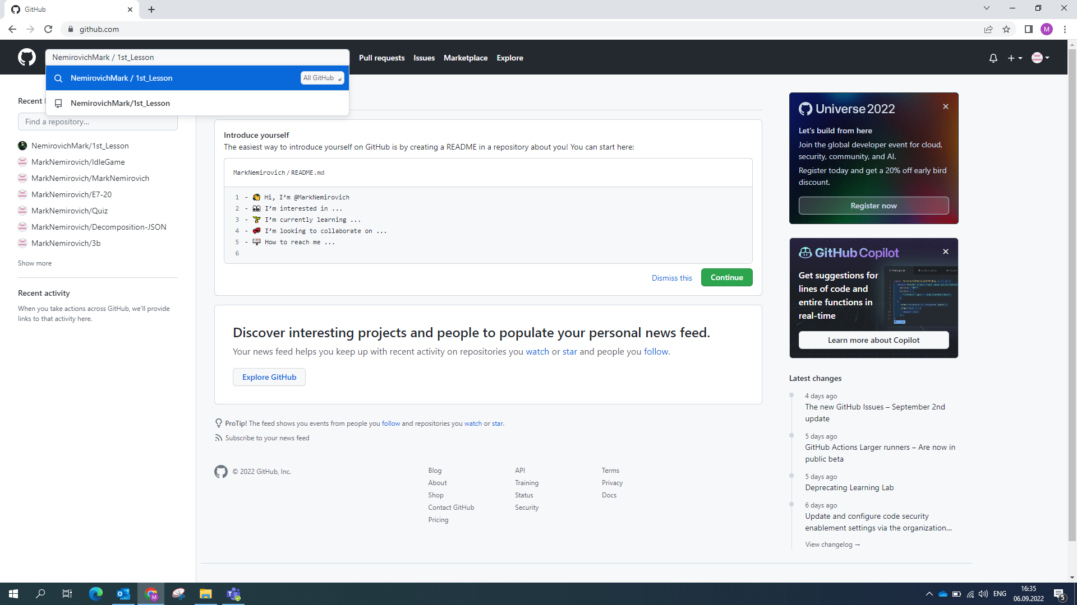
Find the project (or use link I provided in the message)

Slide 3
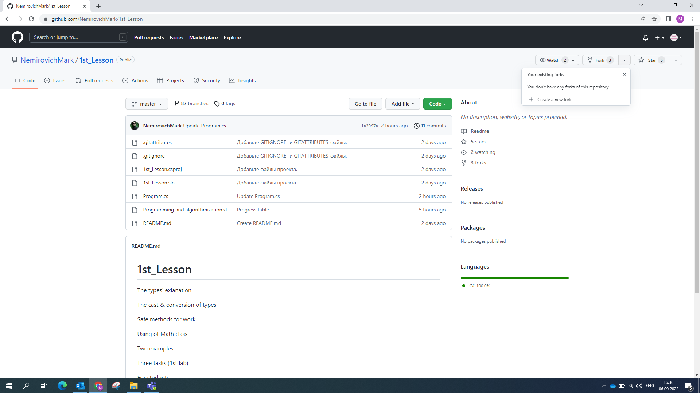
Create a new fork to this project (once each lab)

Slide 4
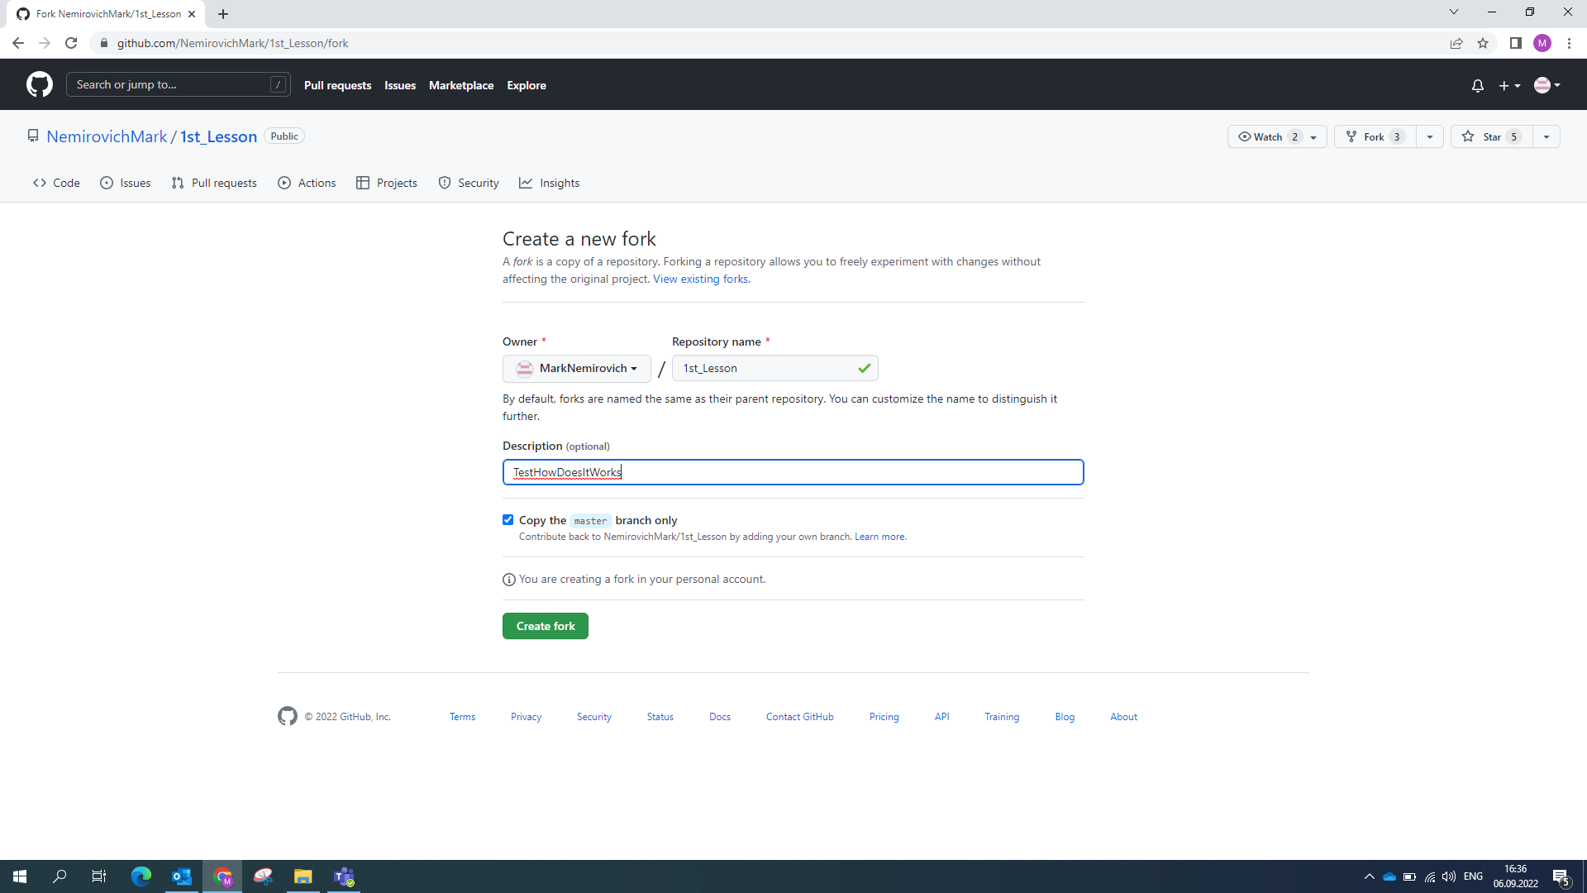
Copy only “master” branch

Slide 5
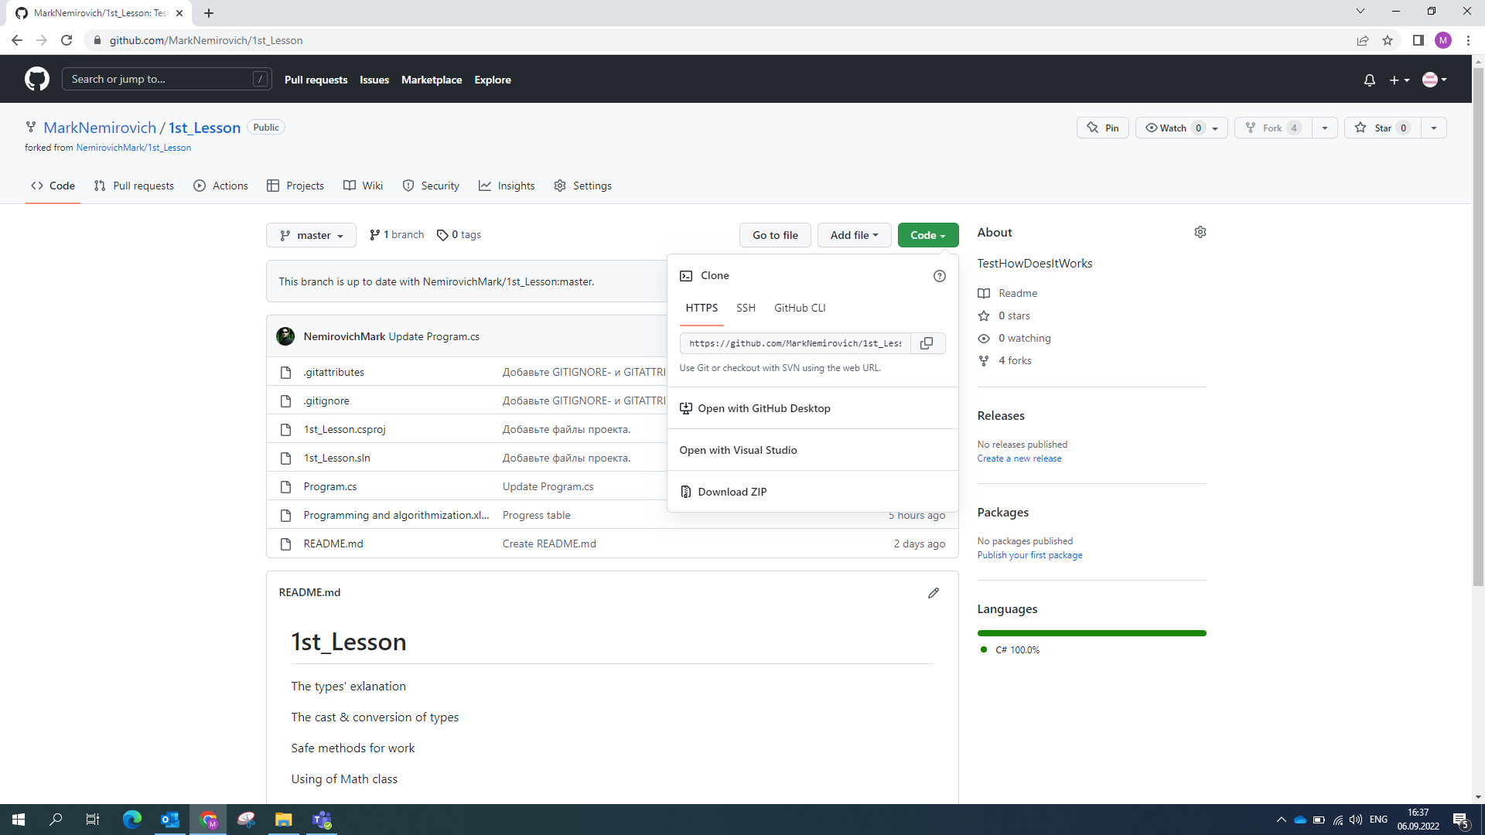
You can open this project in VS or download it, or just copy Program.cs file and change in any editor

Slide 6
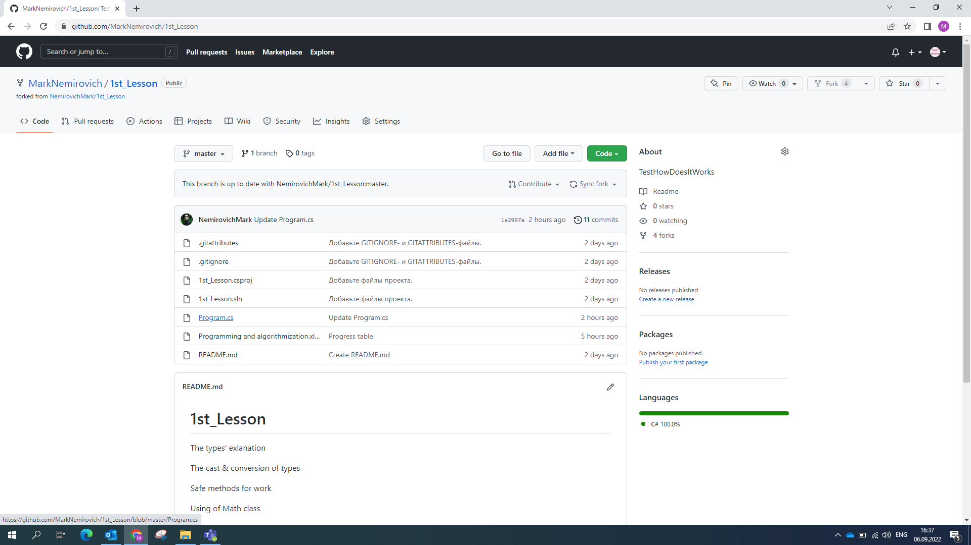
You can even open it here

Slide 7
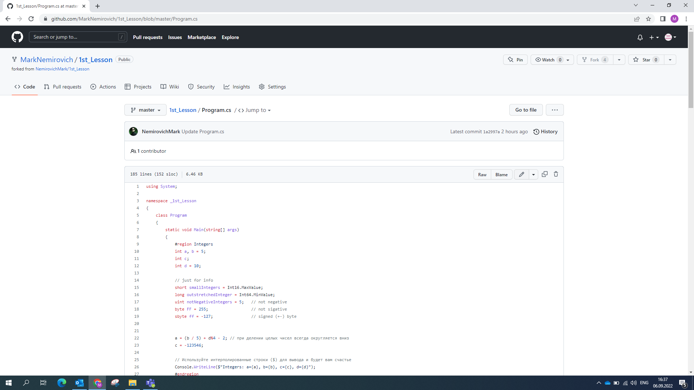
And edit

Slide 8
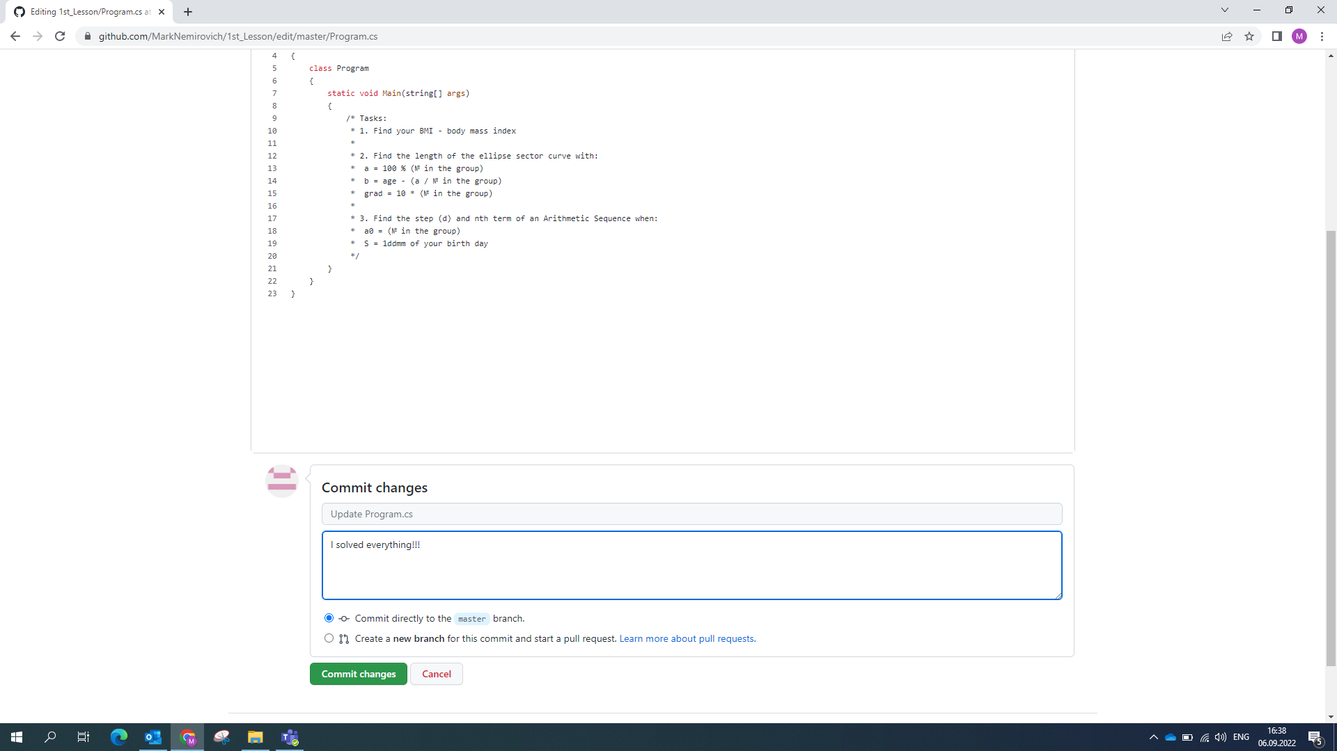
Write here for yourself (not to forget)

Slide 9
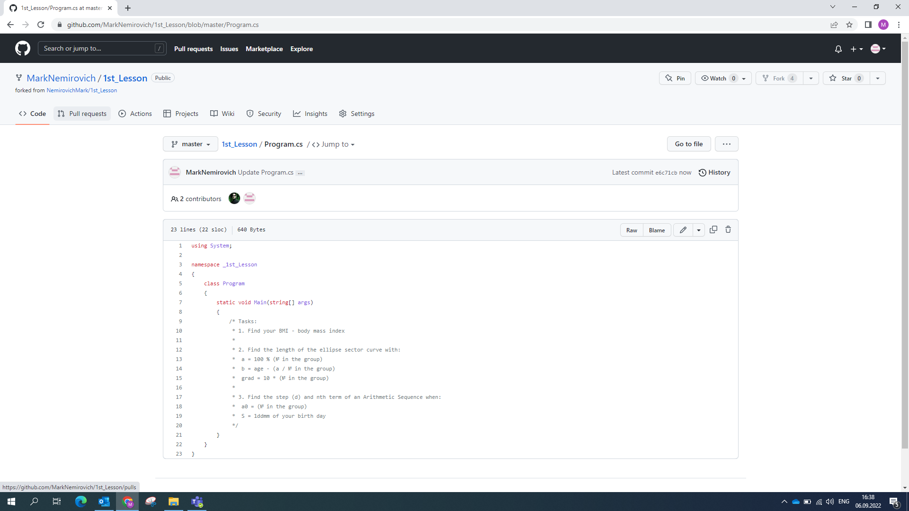
And go to Pull requests to inform me

Slide 10
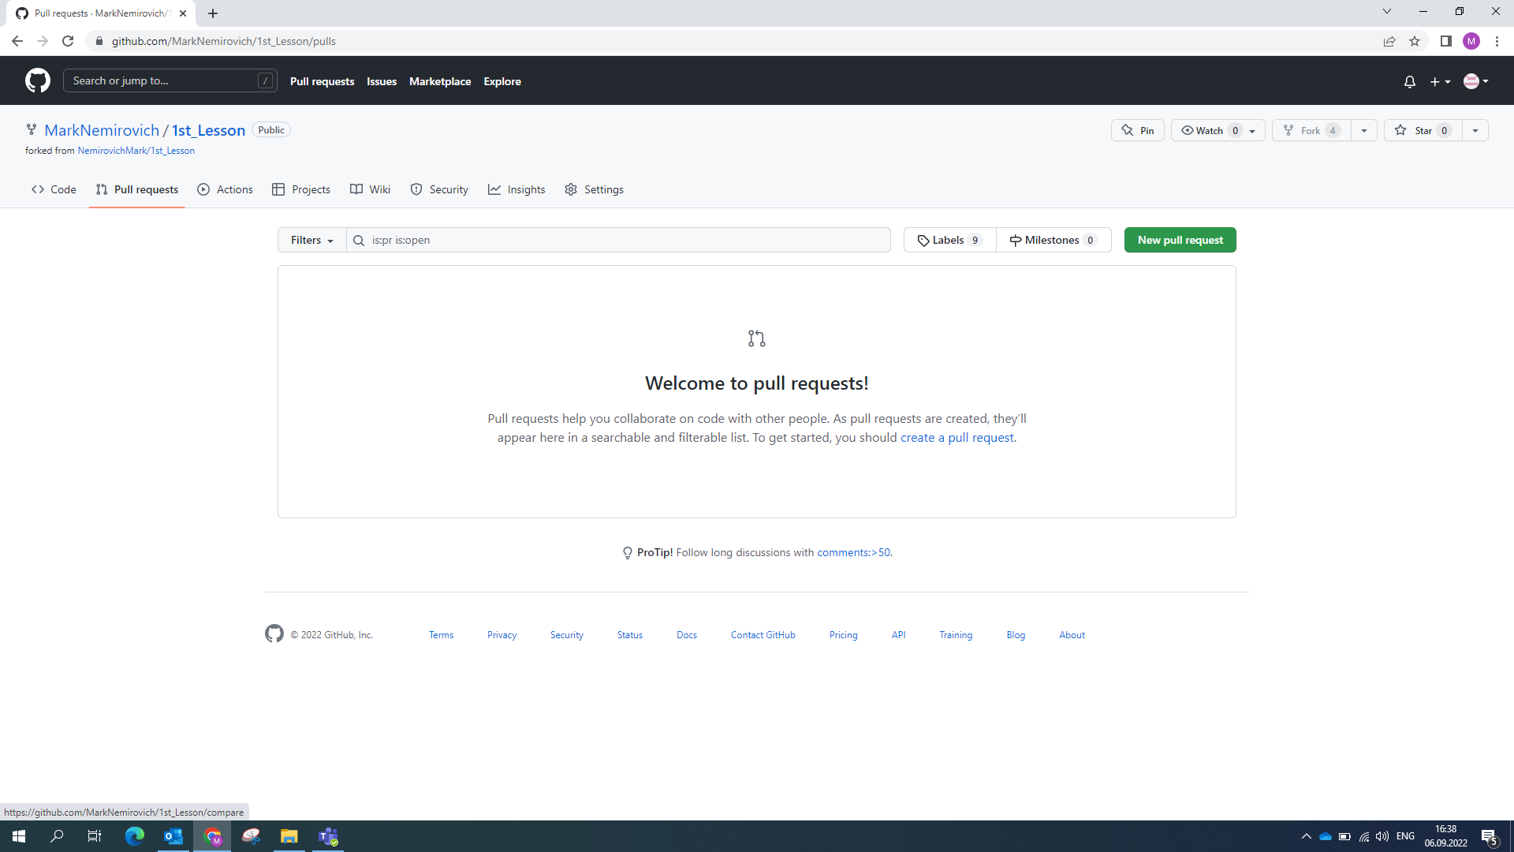
Create new request (or open closed by me)

Slide 11
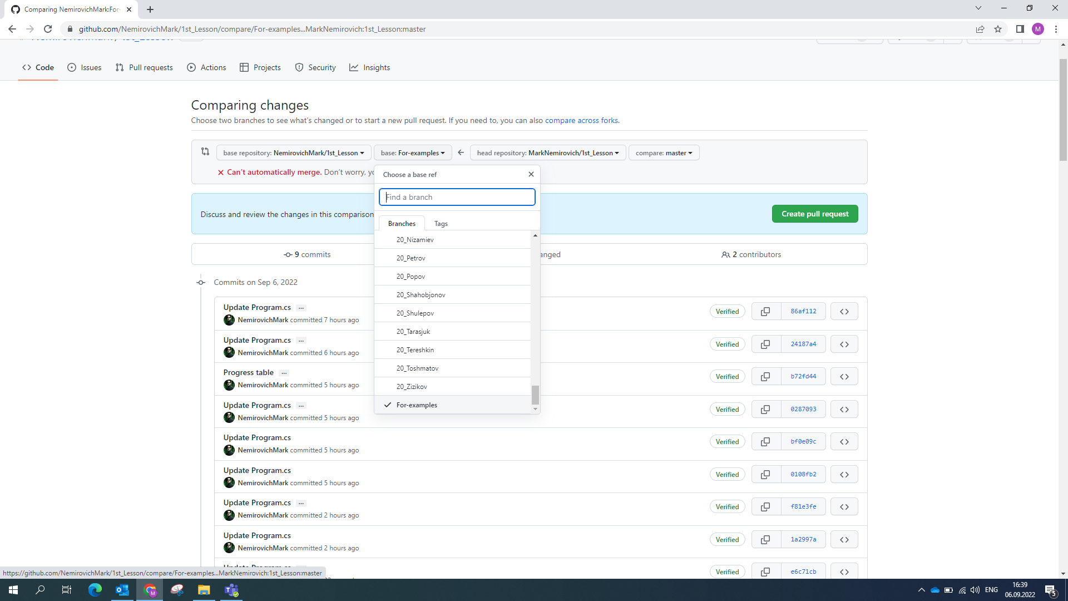
Choose your branch(!) type your surname (or start with group № [17/18/20] + _)

Slide 12
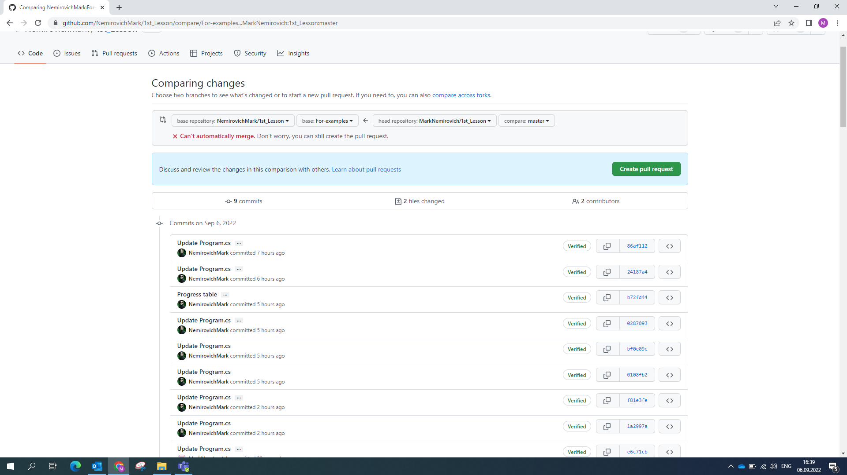
Then create request

Slide 13
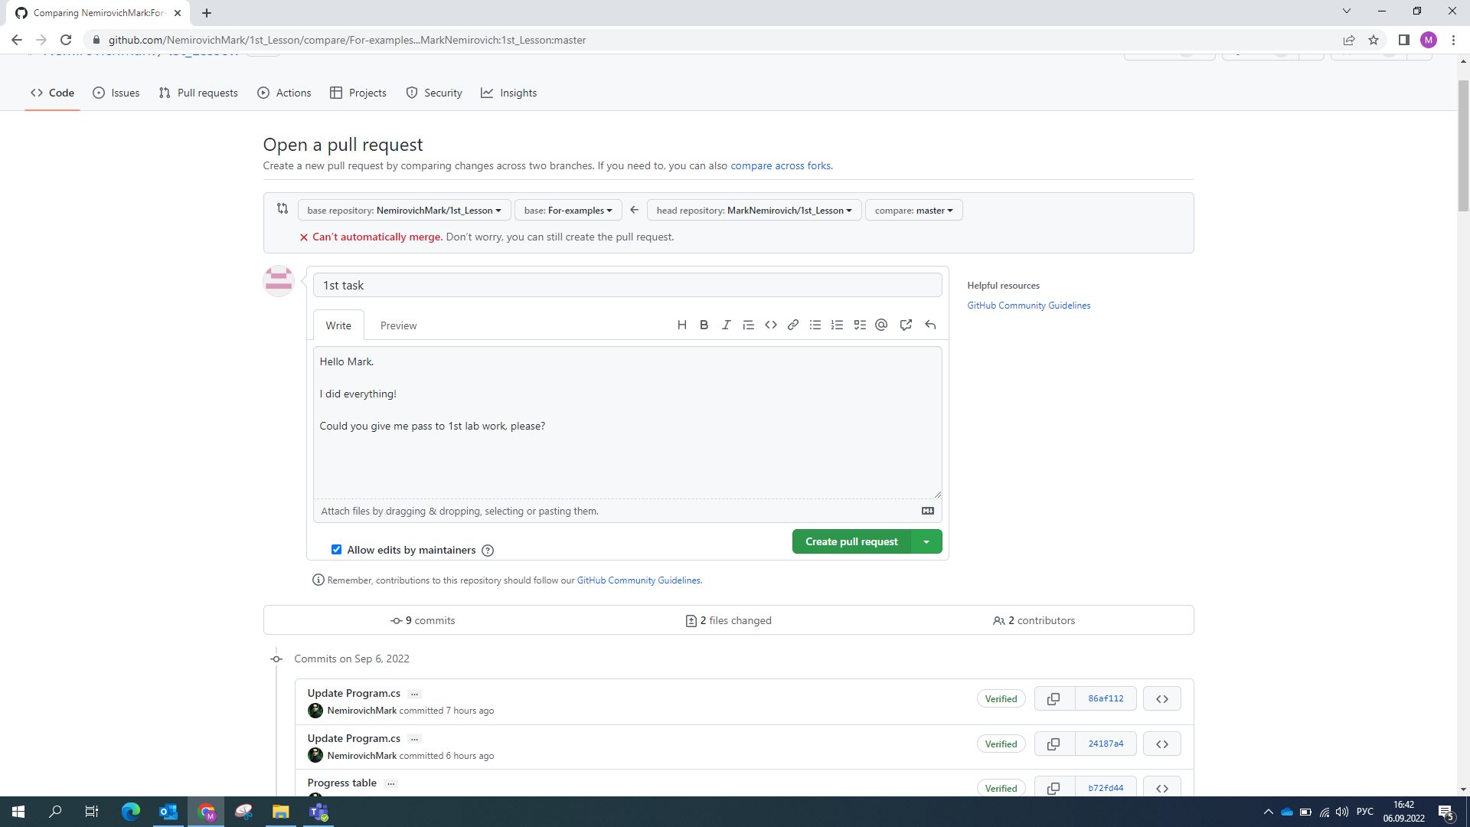
Write here what you did

Slide 14
Gool luck!
and may the Google be with you ☺

